Slide 1
Adherence to ​Anti-seizure Medications​
Avani C. Modi, Ph.D.​
Professor​ | Cincinnati Children’s Hospital Medical Center; University of Cincinnati-College of Medicine​
Aimee W. Smith, Ph.D.​
Assistant Professor​ | East Carolina University​

Slide 2
What is adherence?​
Adherence is defined as the extent to which a person’s behavior coincides with medical or health advice.^{1,2} ​

Slide 3

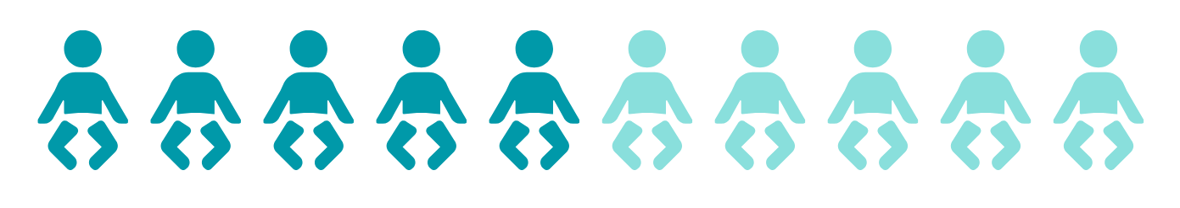
What is the prevalence of non-adherence to ASMs in epilepsy?
25-50% of Adults
43-58% of Children

Slide 4
Why does adherence matter?​
Continued seizures ⁸⁻¹⁰
Poor quality of life ^{11,12}​
Unnecessary ASM changes ¹³​
Non-adherence can lead to:​
Higher healthcare costs ¹⁴
Higher healthcare utilization ^{14-16​}
Pharmacoresistence ¹⁷​
Death ^{5,18} / Sudden unexpected death in persons with epilepsy ^{19​}

Slide 5
How do you measure adherence? ​
Strengths
Inexpensive​
Easy to obtain​
Simple​
Limitations
Generally an overestimate​
Poor accuracy​
Provider Estimate​
Strengths
Inexpensive​
Objective​
Limitations
Variable prescription sources or unknown source​
Does not account for samples​
Presumptive dosing​
Potential for medication discarding​
Requires patients bring prescriptions back to clinic​
Pill Counts

Slide 6
How do you measure adherence? ​
Prescription Refills/ Medication Possession Ratio
Strengths
Easy to collect in managed care setting​
Inexpensive​
Limitations
Presumptive dosing​
Potential for medication discarding​
Strengths
Continuous measurement of adherence​
Provides precise data​
Provides objective data​
Limitations
Expensive​
Technical problems​
Lost monitors​
Presumptive dosing​
Electronic Monitors​

Slide 7
How do you measure adherence? ​
Strengths
Objective​
Quantifiable​
Sensitive to dosing regimens​
Limitations
Affected by pharmacokinetic variation​
Short-term-only reflects past 48-72 hours​
Invasive​
Blood serum levels​
Strengths
Objective​
Quantifiable​
Sensitivity​
Less invasive than blood serum testing​
Limitations
Debatable effectiveness​
Affected by pharmacokinetic variation​
Hair serum levels​

Slide 8
How do you measure adherence? ​
Strengths
Objective ​
Quantifiable​
Painless (no venous access needed)​
Limitations
Debatable efficacy​
May be affected by pharmacokinetic variation​
Needs calibration to individual saliva production​
Saliva concentration
Strengths
Easy to obtain​
Assesses patient perception​
Inexpensive​
Comprehensive​
Can obtain multiple perspectives ​
Limitations
Social desirability​
Recall biases​
Cannot be obtained from young children​
Self-report​

Slide 9
How do you measure adherence? ​
Validated questionnaires​
Morisky Medication Adherence scale ​
Pediatric Epilepsy Medication Self-Management Questionnaire ​
Adult Epilepsy Self-Management Measurement Instrument.​
If validated questionnaires cannot be used, open-ended and non-judgmental questions in clinical practice should be used:​
“Most people miss doses of their medication at some point in time, what has your experience been with your AED in the past week? How many doses do you think you have missed?”​

Slide 10
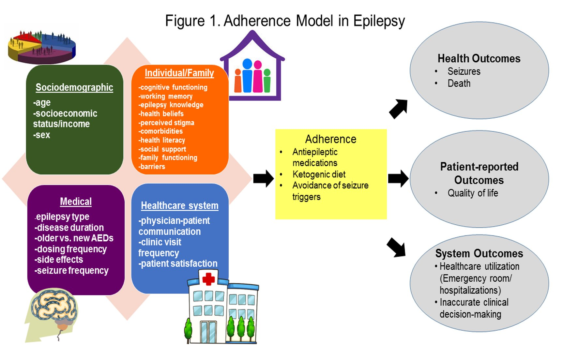
Figure from “Smith, A.W., Gutierrez-Colina, A.M., Guilfoyle, S.M., & Modi, A.C. (2020). Pediatric Epilepsy. In A.C. Modi & K.A. Driscoll (Eds). Adherence and Self-Management in Pediatric Populations (pp. 207-227). Cambridge: Elsevier S&T Books” used with permission from Elsevier.​.​

Slide 11
Risk factors for non-adherence​
Sociodemographic Factors and Social Determinants of Health:​
  Age
  Adherence is worse for adolescents and young adults ^{24,25} compared to other age groups. ​
  Socioeconomic status/income
  Low income or socioeconomic status is associated with non-adherence. ²⁶⁻²⁹ ​
  Sex
  No major sex differences have been found consistently; however, adherence needs to be carefully examined in pregnant women who may worry about the effects of ASMs on the fetus ³⁰.​
  Race
  Black individuals with epilepsy experience higher rates of suboptimal adherence ³¹ and more system and community level adherence barriers compared to other racial groups. ^{23,32​}

Slide 12


Adherence Barriers Ranking by Race and Outcome​
  Black
  White
  Seizures
  Seizures
  Running out of Medications*
  SDS = 0.284
  Forgetfulness
  SDS = 0.380
  Competing Activities*
  SDS = 0.193
  Difficulty Swallowing
  SDS = 0.132
  Pharmacy*
  SDS = 0.192
  Pharmacy
  SDS = 0.122
  Adherence
  Adherence
  Unpleasant Taste
  SDS = 0.098
  Refusal
  SDS = 0.077
  Pharmacy*
  SDS = 0.091
  Running out of Medications
  SDS = 0.070
  Forgetfulness
  SDS = 0.080
  Pharmacy
  SDS = 0.031
  Note. The asterisk denotes medication adherence barriers more highly endorsed by Black families compared to White families. SDS = Standardized Dominance Statistic

Slide 13
Risk factors for non-adherence​
Medical Predictors:
  Epilepsy Type
  Some studies find lower adherence for individuals with localized seizures ¹⁶ whereas others find lower adherence for generalized seizures. ^{25,33​}​
  Disease Duration
  Adherence typically declines over time, ^{34,35} with the best adherence exhibited in the first 6 months. ​
  Older vs Newer Gen ASMs
  Higher adherence is associated with the use of newer versus older AEDs ^{3,16​}
  Dosing Frequency
  Less frequent dosing is ideal to improve adherence ⁶, with non-adherence being worse for dosing that is greater than 2 times a day. ^{3​}

Slide 14
Risk factors for non-adherence​
Medical Predictors:
  AED Side Effects
  Real or perceived side effects of ASMs is related to non-adherence. ^{35-38 ​}
  Seizure Frequency
  Although seizures are usually considered an outcome of poor adherence, they may also negatively influence adherence behaviors. ³⁹⁻⁴¹ ​

Slide 15
Risk factors for non-adherence​
Individual and Family Predictors of Adherence:
  Cognitive Function
  The patient’s and family’s ability to think clearly and problem-solve barriers that impact adherence ⁴² (e.g., change in schedule, titration or switch in medicines) results in better adherence compared to individuals or families with cognitive difficulties (e.g., low IQ ⁴³).​
  Health Beliefs
  Patient beliefs and perceptions about their health and their illness impact adherence behaviors. ^{39,47-50} For example, believing epilepsy is a spiritual/psychological problem is associated with higher use of complementary and alternative therapies over AED adherence. ^{51​}
  Lack of Knowledge
  Knowledge about epilepsy and its treatments is associated with better adherence. ^{42,45,46}
  Executive Functioning
  Better memory is associated with better adherence. ⁴⁴

Slide 16
Risk factors for non-adherence​
Individual and Family Predictors of Adherence:
  Perceived Stigma
  Perceived stigma is associated with worse adherence. ^{35,52}
  Social Support
  Increased social support is a predictor of better adherence. ^{35,50,59​}
  Psychological Comorbidities
  Depression, ^{44,53,54} anxiety ⁵⁴, and behavior problems ⁴³ negatively impact adherence. Parental fears and stress are also predictive of AED non-adherence. ^{55,56​}
  Health Literacy
  Lower health literacy (e.g., the degree to which individuals have the capacity to obtain, process, and understand basic health information and the services need to make appropriate health decisions ⁵⁷) is associated with poorer adherence. ^{58​}

Slide 17
Risk factors for non-adherence​
Individual and Family Predictors of Adherence:
  Family Functioning
  Better family problem-solving and communication are significant predictors of adherence in children ^{28,42} and adolescents. ⁶⁰
  Barriers
  Individual and family-identified barriers can impede adherence and include forgetting ^{21,36,37,39,61-63}, difficulty obtaining medication ^{37,64}, difficulty swallowing pills, poor AED taste, embarrassment in taking ASMs in front of others, and competing activities/inconvenience. Barriers are different depending on patient developmental stage and race. ^{23,65}

Slide 18
Risk factors for non-adherence​
Healthcare System Predictors of Adherence:
  Physician-Patient Communication
  Poor communication between providers and patients results in worse adherence (e.g., misunderstanding dosing). ^{38​}
  Clinic Visit Frequency
  More frequent clinic visits typically results in better adherence, ^{66,67} which may be due to more frequent monitoring or white coat adherence (e.g., adherence increases prior to and after clinic visits).
  Patient Satisfaction
  A positive relationship between patient and physician results in better adherence. ^{37,50} Additionally, patient satisfaction with the healthcare they receive more broadly (e.g., shared decision making) can improve adherence. ^{56​}

Slide 19
Adherence interventions​
  Population
  20 total trials
  13 Adults
  5 Children and/or families
  2 Broad age ranges
  Intervention Type
  Education-only interventions (n=13)
  Behavioral interventions (n=4)
  Mixed interventions combining approaches (n=4 overlap)​
  Details
  Follow-up ranged from 1 to 12 months
  17 trials compared against usual care or no intervention
  Key Findings
  Educational interventions: mixed results
  Behavioral interventions: more consistently favorable effects
  Mixed interventions: improved adherence compared to controls

Slide 20
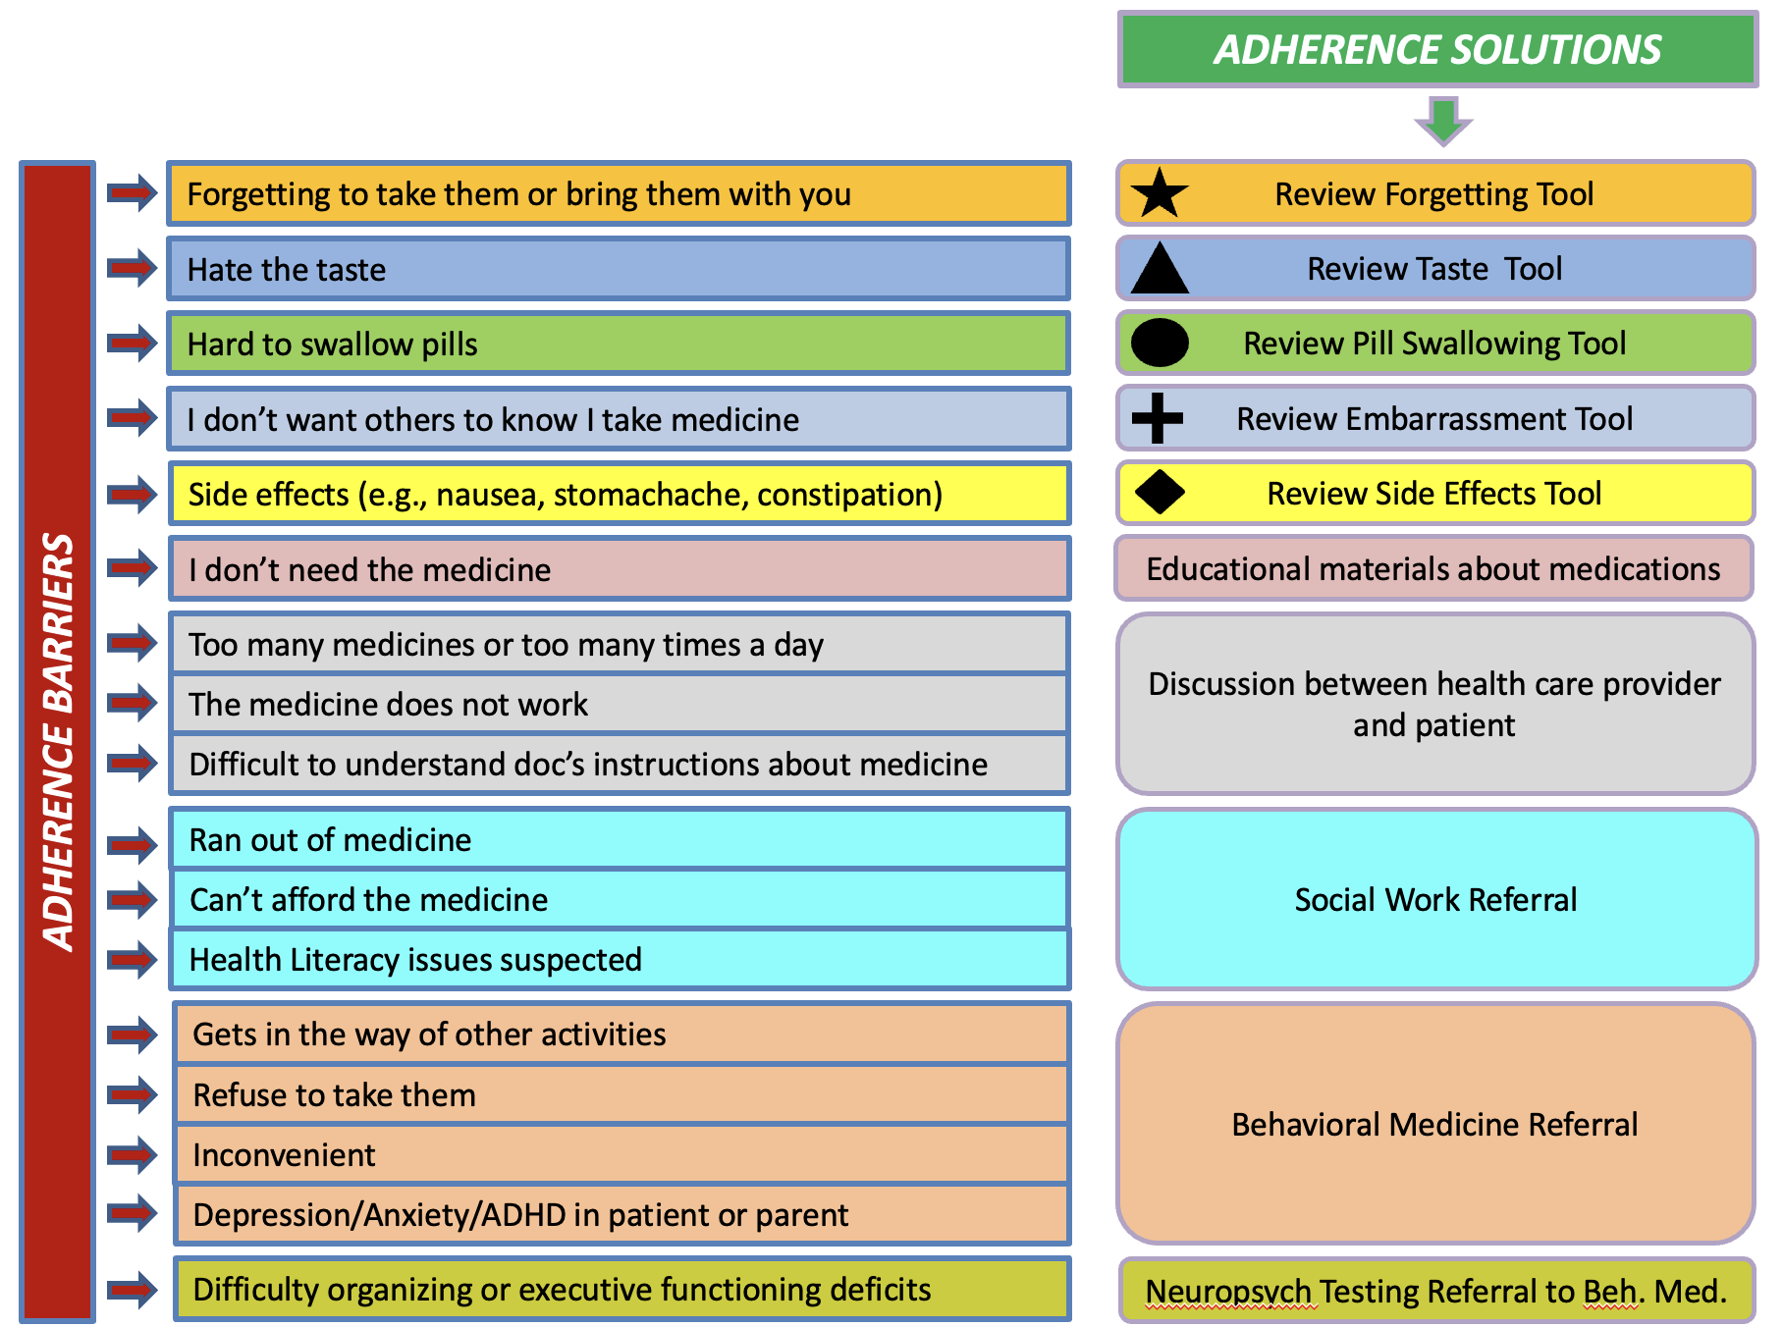
Strategies to improve adherence should be tailored to individual patients and their relevant risk factors. ​

Slide 21

Adherence Tool for Clinical Practice​
  The Epilepsy Learning Health System, in conjunction with the Epilepsy Foundation, has created shared-decision making and patient handouts to address common adherence barriers. These can be useful for caregivers of children and the elderly, as well as adult patients.
  Find the resources here: ​
www.epilepsy.com/tools-resources/forms-resources/medication-tools

